Slide 1
ITS HR/PAYROLL
Session 47 Self Service Training and Development
Presented by Allie de Nysschen

Slide 2
DISCLAIMER
This presentation is only a summary of some of Adapt IT’s products, features and their latest developments. Adapt IT only intends for the information to give you an overview, and not a complete and comprehensive statement that necessarily suits your purposes.
Adapt IT reserves the right to change any information contained in this presentation and is not responsible for any loss that results from inaccuracies in the information. You may not distribute or reproduce the information without Adapt IT’s written permission.

Slide 3
Table of contents
Design principles
Benefits of this system
Processes
Prerequisites to Implement this Development
Walkthrough high level Detail

Slide 4
Design principles

Slide 5
Design Principles
Integrated Design
Decentralized Data Capture
Controlled by HR
Rich Data Set used for SETA Reporting

Slide 6
Benefits of this system

Slide 7
Benefits
Supports data selection for required courses, Questions regarding training requirements for individual development plans can
be customised for specific groups based on the ranks, occupational categories or appointment types of personnel.
The system caters for scheduled courses as well as for ad hoc requests
Decentralized applications for courses
The application process has an approval process built in with automated notifications which is user definable
Course applications are only allowed for relevant staff per Occupational level
Controls the min number of applications required, cut off dates and caters for a waiting list
Controls max nr of times a person may register for a course
Centralized database to prevent data duplication
Rich data set that can be used for SETA reporting
Applications for courses on behalf of personnel reporting too you
Online query functionality, course rating, course cancellation
Employers can claim back up to 20% of their skills levy by submitting their Annual Training report, Work place skills plan by 30 April each year. What is 1% of your payroll?

Slide 8
Benefits
South Africa’s 26 higher education institutions spent R40 billion on compensation of employees in the 2018 financial year.
1% of R40 Billion = R400 000 000
20% of R400 000 000 = R80 000 000
In 2024 if we take an average increase of 4.5% per year the salary bill would have been roughly 52 billion
Can you afford not to submit your SETA Reports?

Slide 9
Processes

Slide 10
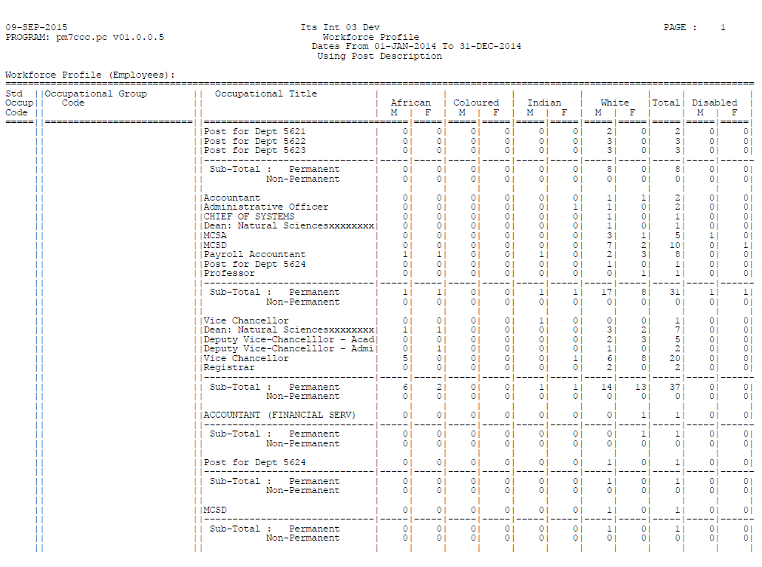
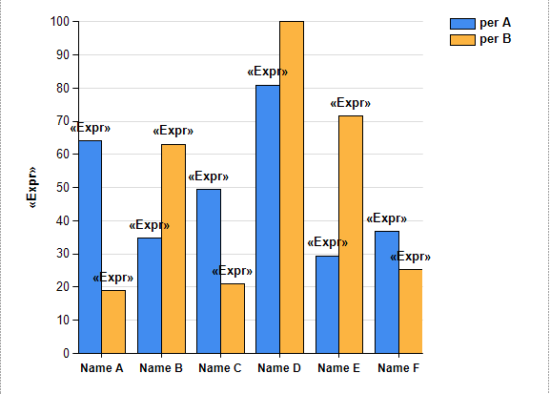
Processes – Data collection for PDP courses to be scheduled
Schedule Courses in the skills development system
Course requests received

Slide 11
Processes – Request for Ad Hoc courses to be scheduled
Schedule Courses in the skills development system
Book personnel on course
Create and Schedule courses
Course requests received

Slide 12
Processes – Application for courses

Slide 13
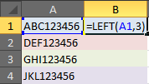
Processes – Reporting

Slide 14
Prerequisites to Implement this Development

Slide 15
Prerequisites for the implementation
Pre-requisites for the operation of the Staff Booking System.
Setup of code structures
{GCS-22} - Link Creditor codes as Employer codes
{PSDCS-16} Course Rating Codes
{PSDOP1-1} – Assessment codes
{PSDOP-1} – Course contact person
{PSDOP-2} – Training Providers
{PSDOP-3} – Other employment equity groupings
{PSDOP-4} – Cost pricing structure
{PACS-1} – Appointment types
{PACS-2} – Ranks
{PACS-4} – Post codes

Slide 16
Prerequisites for the implementation
Pre-requisites for the operation of the Staff Booking System.
Personnel System – Only in service personnel
{PBOP-1} – Personnel Biographical record
{PBOP-2} – service record
Setup Operational Routing processes
{GROU-1 }

Slide 17
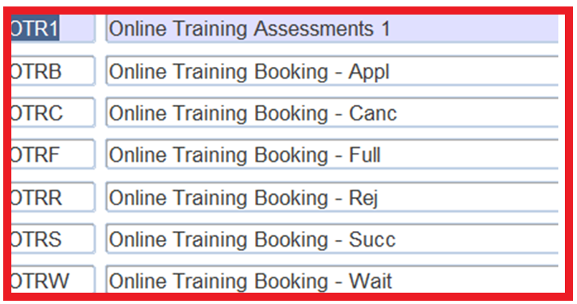
Prerequisites for the implementation

Slide 18
Prerequisites for the implementation
Pre-requisites for the operation of the Staff Booking System.
Operational menus
{PSDOP-5} –Course Details
{PSDOP-6} Course Schedule

Slide 19
Walkthrough high level Detail

Slide 20
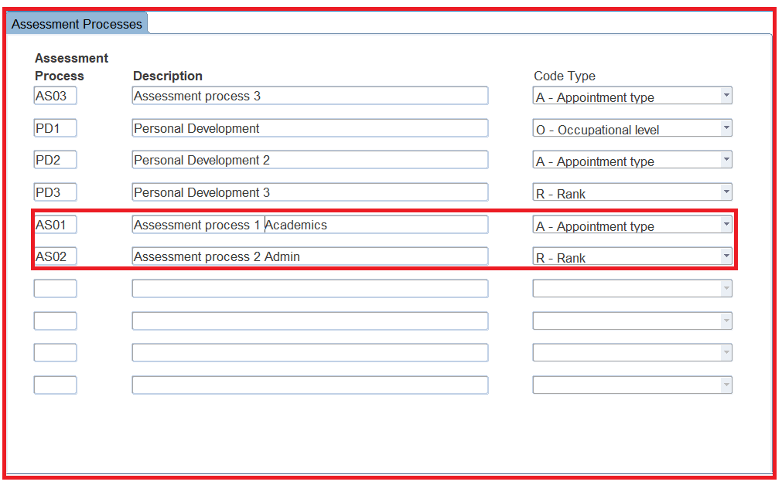
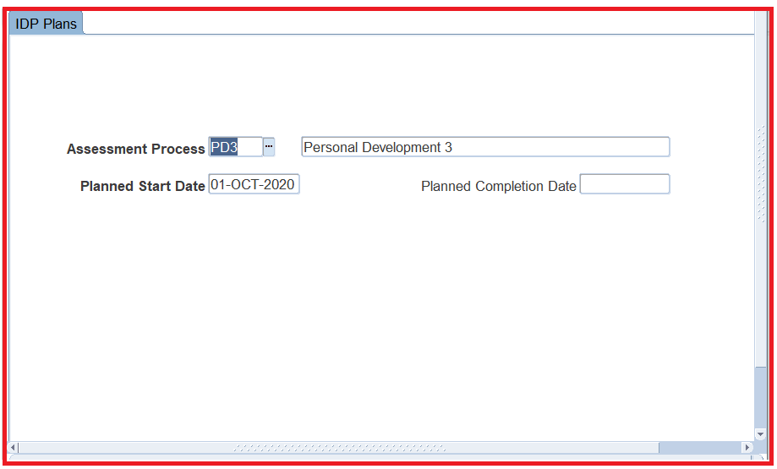
Walkthrough high level detail – Data Collection Process
{PSDOP1-1} – Define Assessment process as well as the base on which it should work
{PSDOP1-2} Define the period in which the Assessment process should be created and completed

Slide 21
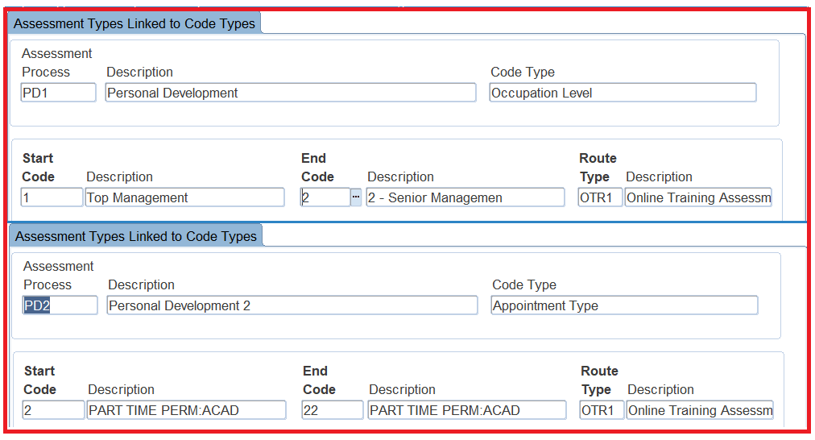
Walkthrough high level detail – Data Collection Processdevelopment
{PSDOP1-3} – Link Assessment codes to code type values Define Assessment process as well as the base on which it should work
{PSDOP1-4} - Setup Assessment basis and link questions groups and questions

Slide 22
Walkthrough high level detail – Data Collection Processdevelopment
{PSDOP1-10} – Copy Assessment question Set

Slide 23
Walkthrough high level detail – Data Collection Processdevelopment
{PSDOP1-7} – Generate Assessment Process

Slide 24
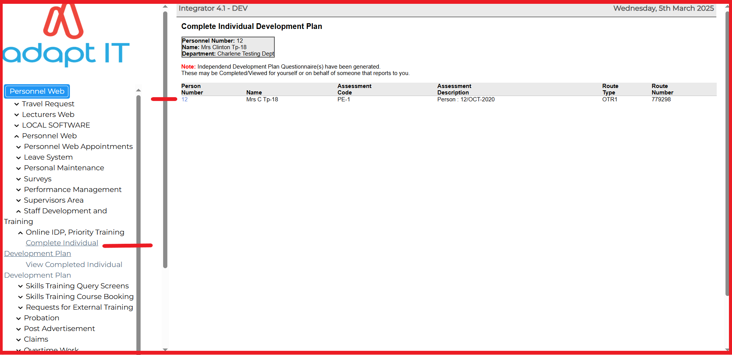
Walkthrough high level detail – Data Collection Processdevelopment
Complete Individual Development Plan on the iEnabler

Slide 25
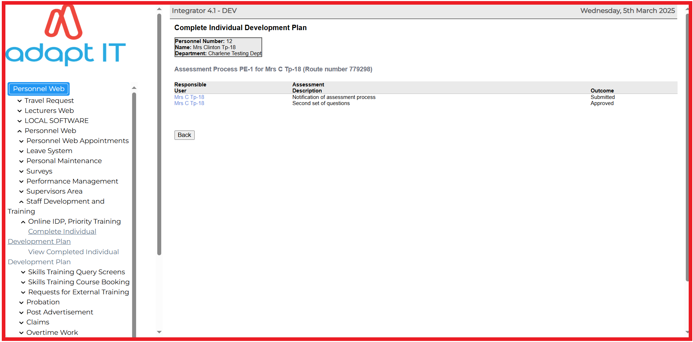
Walkthrough high level detail – Data Collection Processdevelopment
Complete Individual Development Plan on the iEnabler

Slide 26
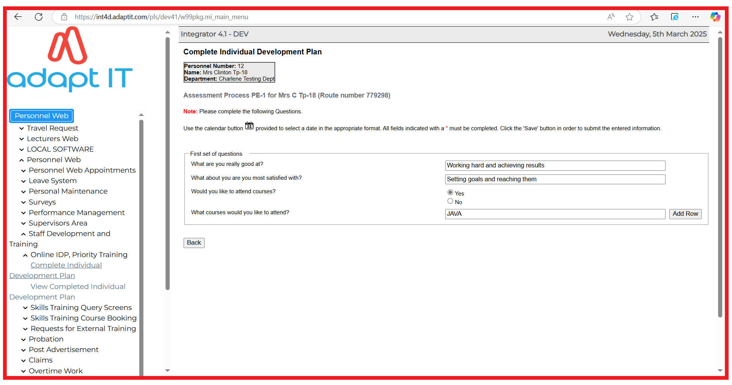
Walkthrough high level detail – Data Collection Processdevelopment
Complete Individual Development Plan on the iEnabler

Slide 27
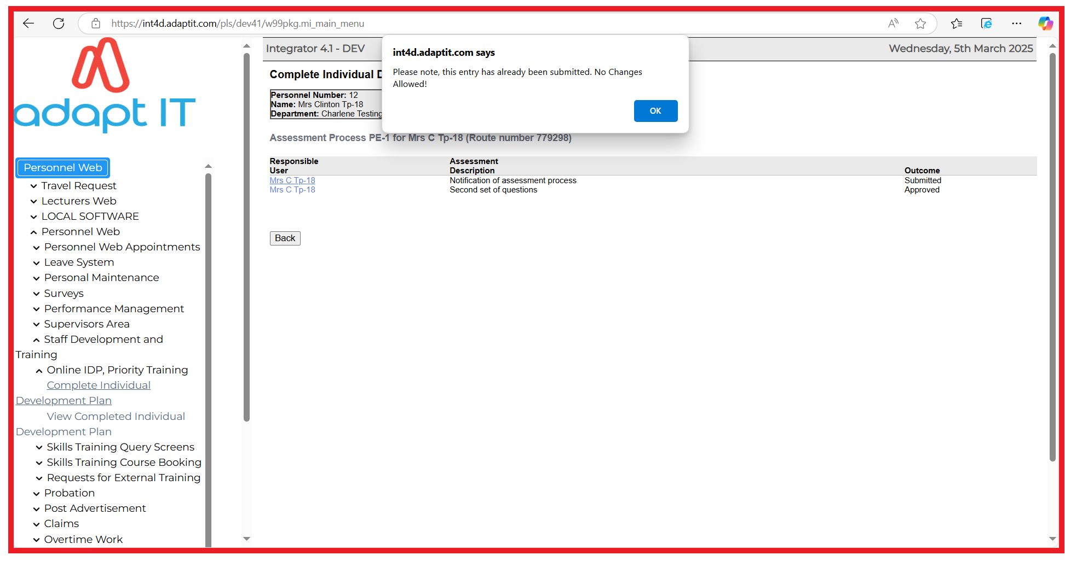
Walkthrough high level detail – Data Collection Processdevelopment
Complete Individual Development Plan on the iEnabler

Slide 28
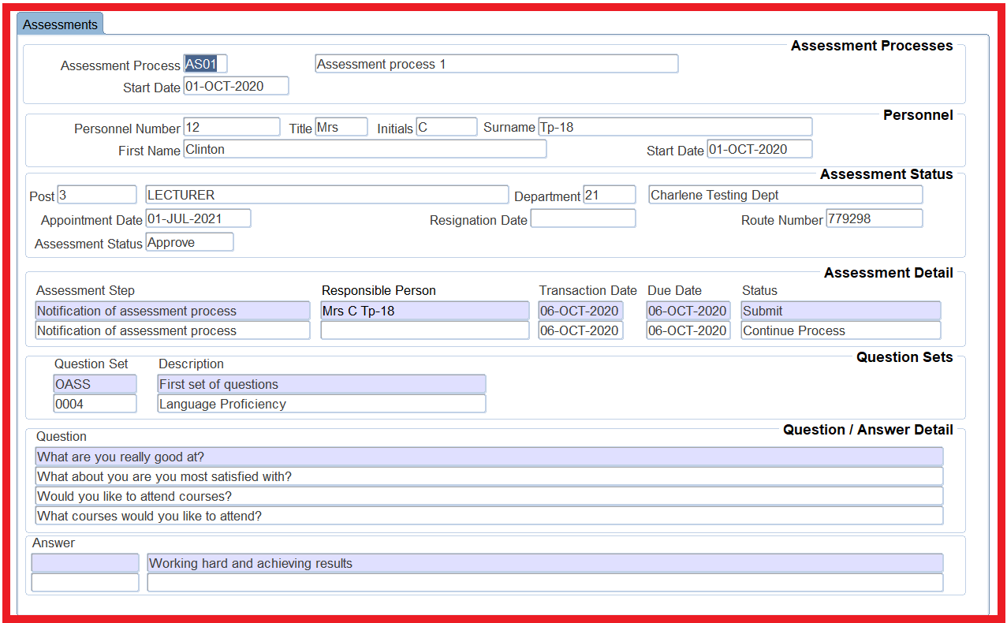
Walkthrough high level detail – Data Collection Processdevelopment
{PSDOP1-5/6} Query Assessment detail

Slide 29
Walkthrough high level detail – Data Collection Processdevelopment
{PSDOP1-9} Query Outstanding Assessment detail

Slide 30
Walkthrough high level detail – Data Collection Processdevelopment
{PSDOP1-8} Extract Assessment detail

Slide 31
Walkthrough high level detail – Data Collection Processdevelopment
{PSDOP1-8} Extract Assessment detail

Slide 32
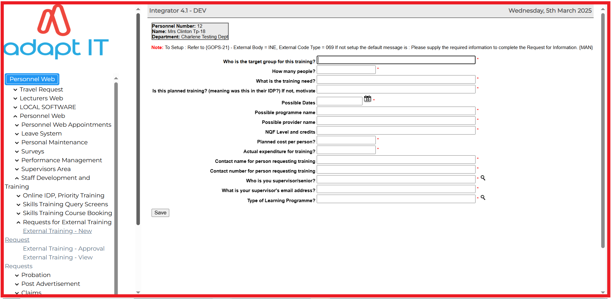
Walkthrough high level detail – Request an Ad hoc Course
{iEnabler Application}

Slide 33
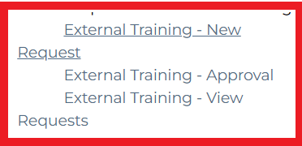
Walkthrough high level detail – Request an Ad hoc Course
{iEnabler Application}

Slide 34
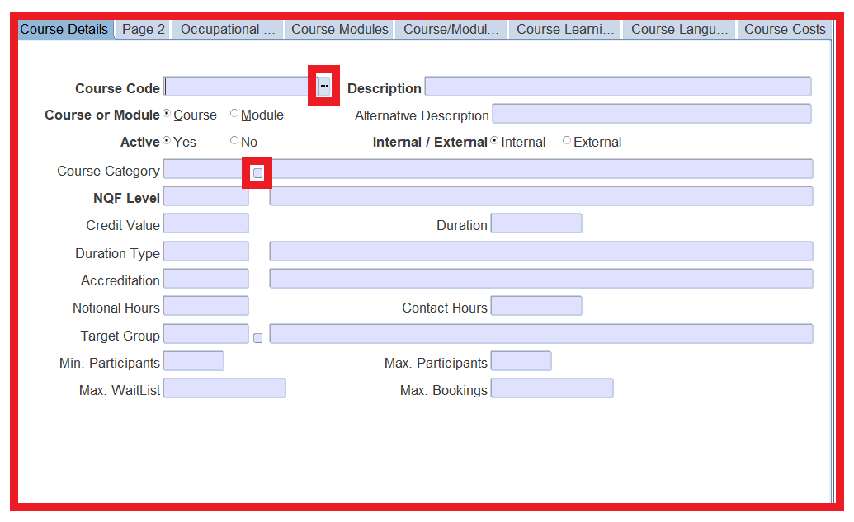
Walkthrough high level detail – Request an Ad hoc Course
HR to capture the course details {PSDOP-5}

Slide 35
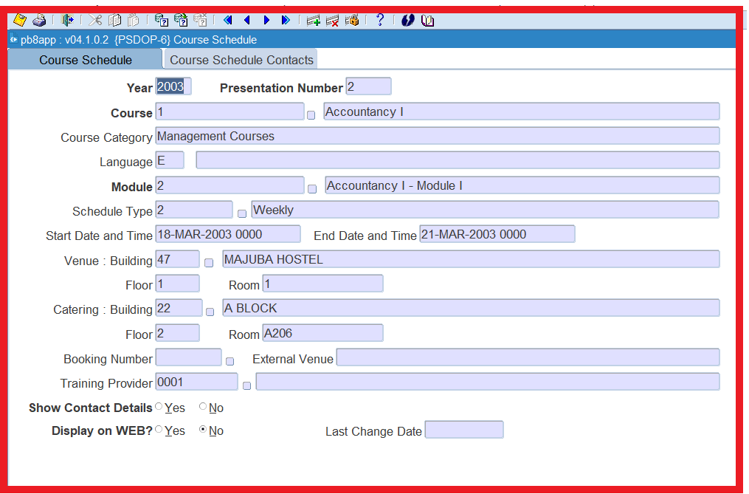
Walkthrough high level detail – Request an Ad hoc Course
HR to schedule the course {PSDOP-6}

Slide 36
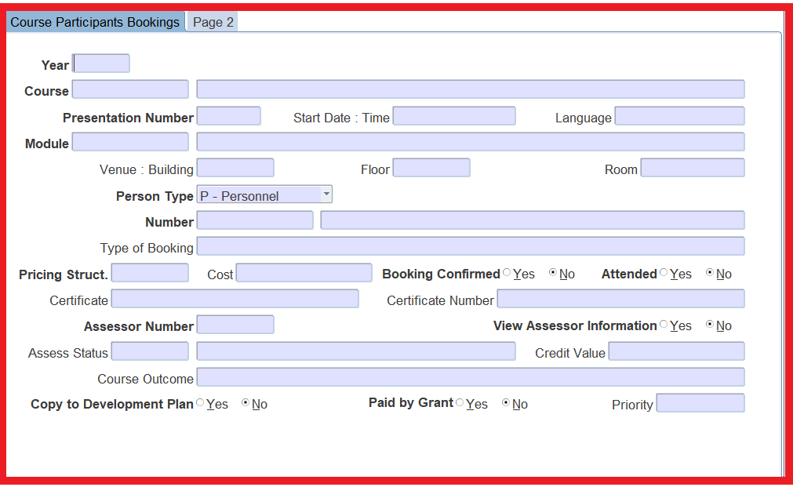
Walkthrough high level detail – Request an Ad hoc Course
HR to book personnel on the course {PSDOP-8}

Slide 37
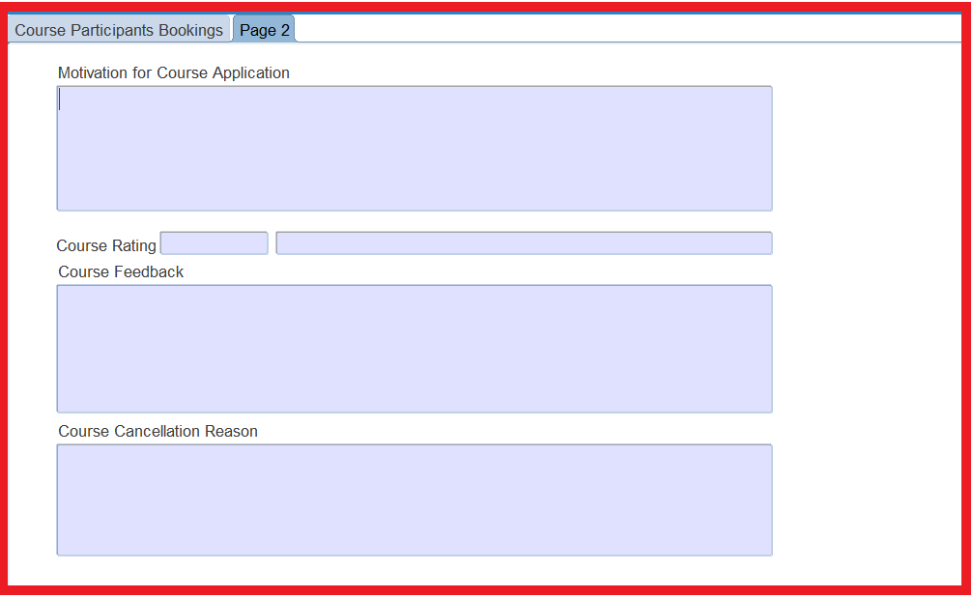
Walkthrough high level detail – Request an Ad hoc Course
HR to book personnel on the course

Slide 38
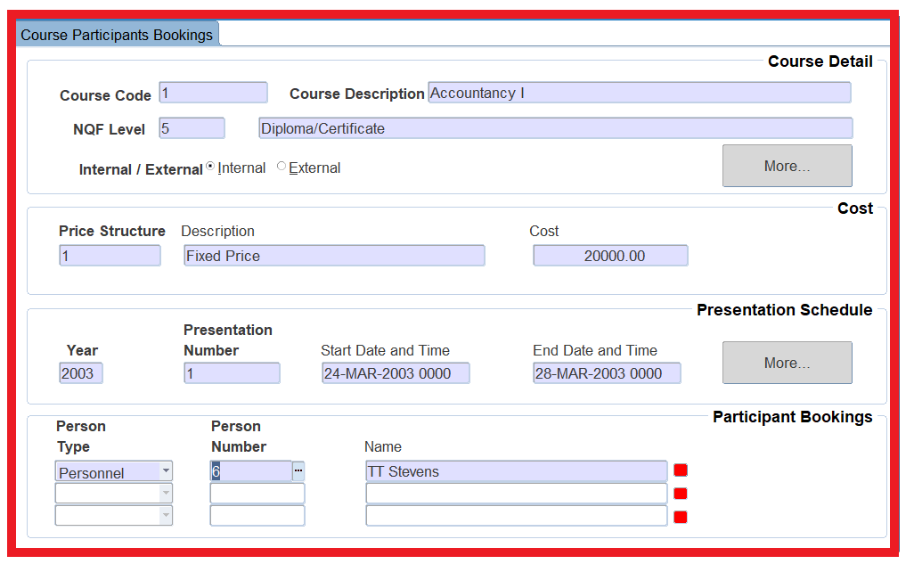
Walkthrough high level detail – Request an Ad hoc Course
HR to book personnel on the course quick Booking {PSDOP-20}

Slide 39
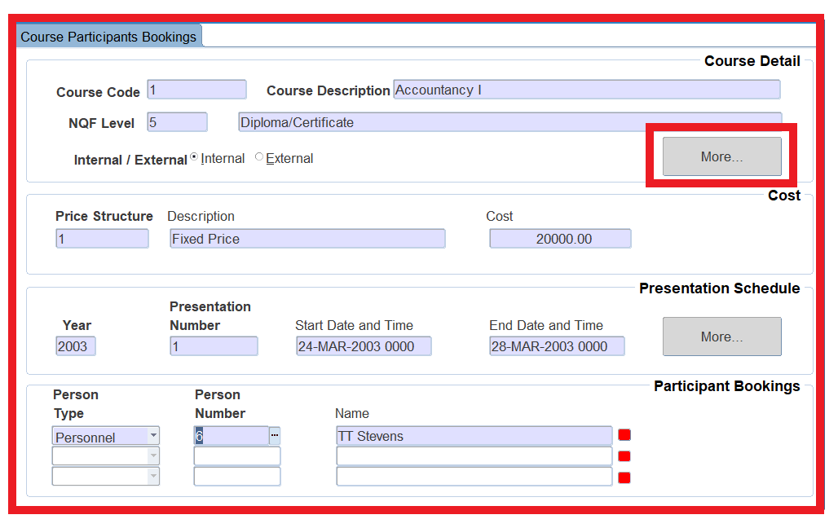
Walkthrough high level detail – Request an Ad hoc Course
HR to book personnel on the Quick Course Booking {PSDOP-20}

Slide 40
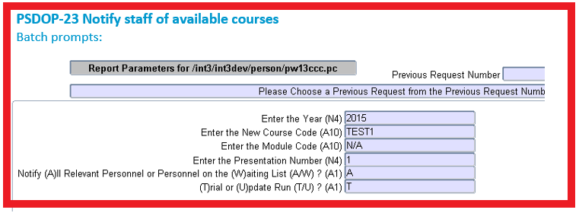
Walkthrough high level detail – Application for Courses
HR to send email notification to personnel Regarding available courses

Slide 41
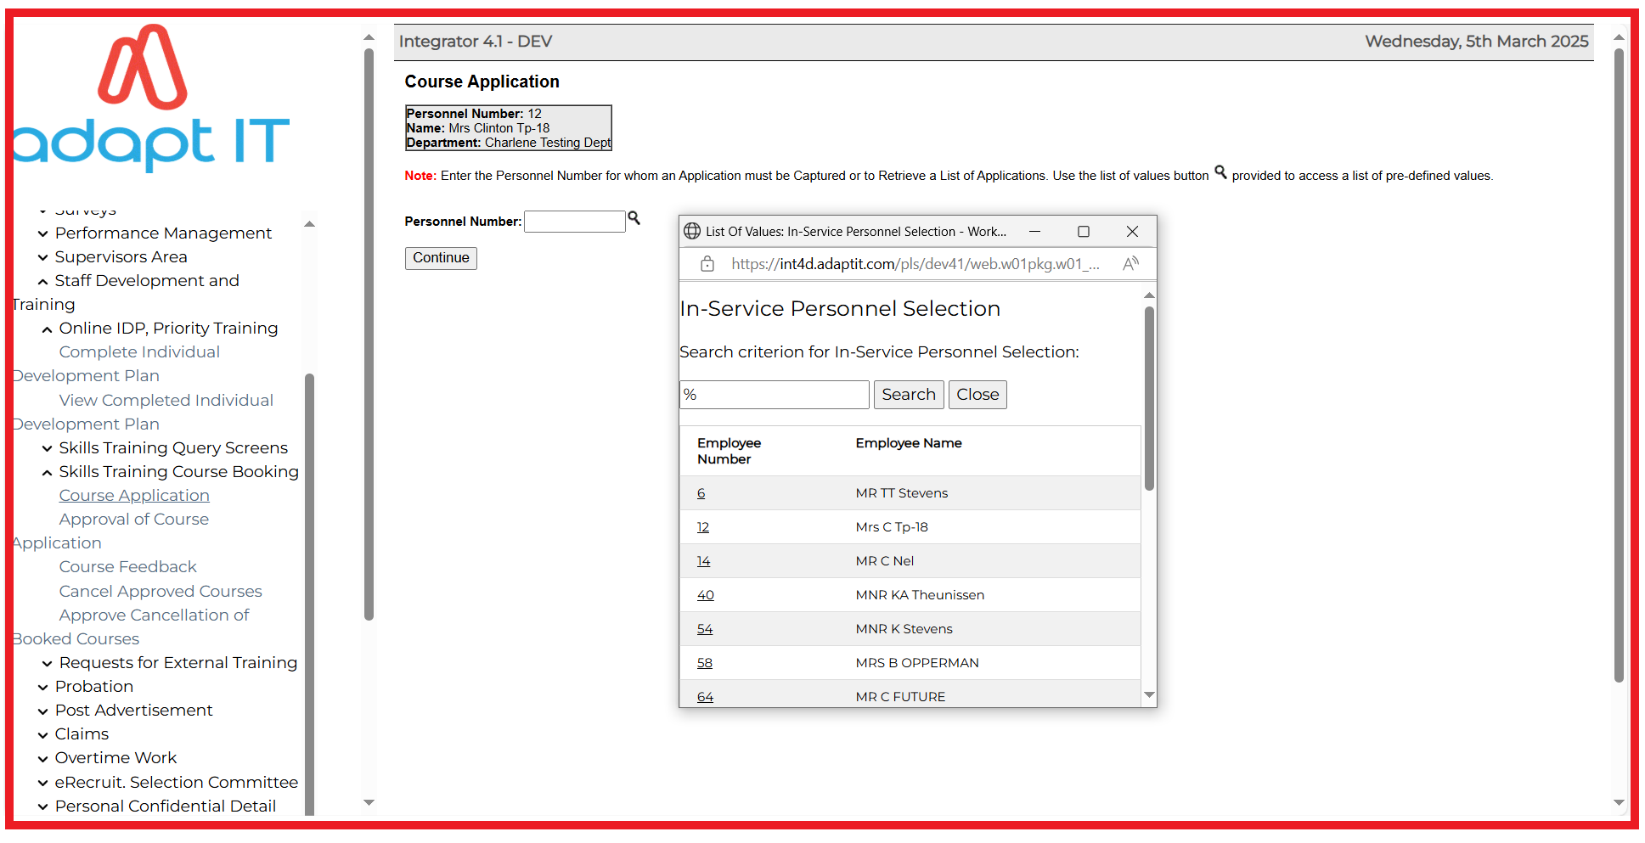
Walkthrough high level detail – Application for Courses
Personnel can now apply for courses

Slide 42
Walkthrough high level detail – Application for Courses
Personnel can now apply for courses

Slide 43
Walkthrough high level detail – Application for Courses
Personnel can now apply for courses

Slide 44
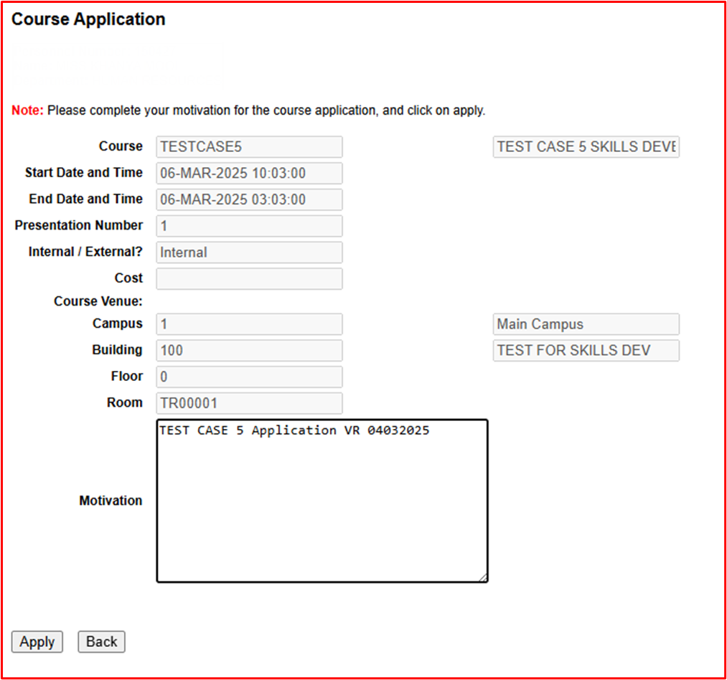
Walkthrough high level detail – Application for Courses
Personnel can now apply for courses

Slide 45
Walkthrough high level detail – Application for Courses
Personnel can now apply for courses

Slide 46
Walkthrough high level detail – Application for Courses
Personnel can now apply for courses

Slide 47
Walkthrough high level detail – Application for Courses
Approval of Applications

Slide 48
Walkthrough high level detail – Application for Courses
Approval of Applications

Slide 49
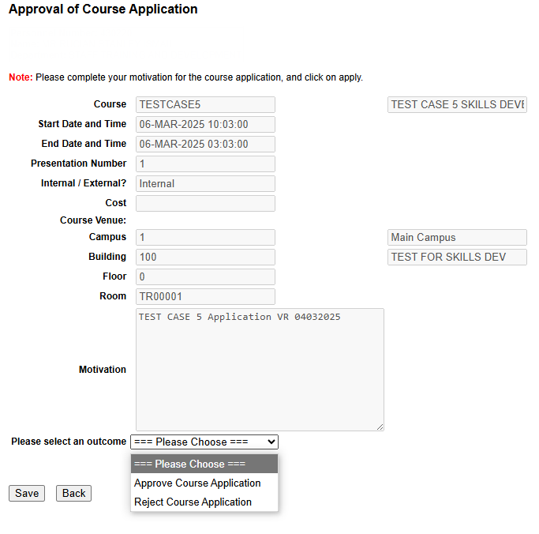
Walkthrough high level detail – Application for Courses
Approval of Applications

Slide 50
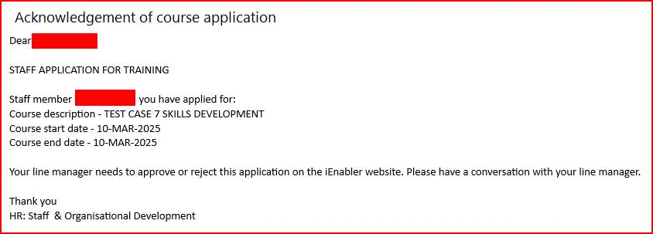
Walkthrough high level detail – Application for Courses
Examples of notifications

Slide 51
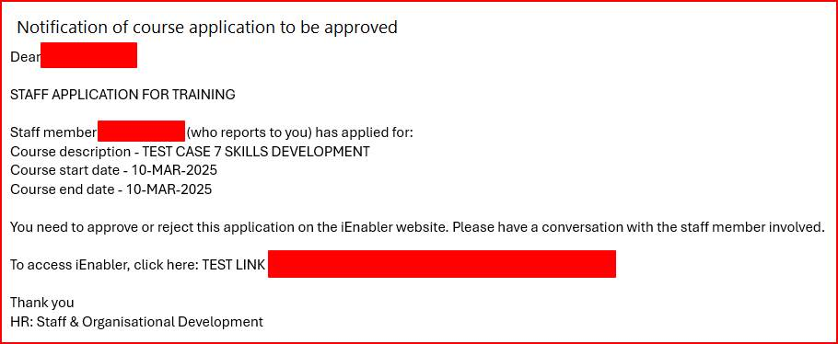
Walkthrough high level detail – Application for Courses
Examples of notifications

Slide 52
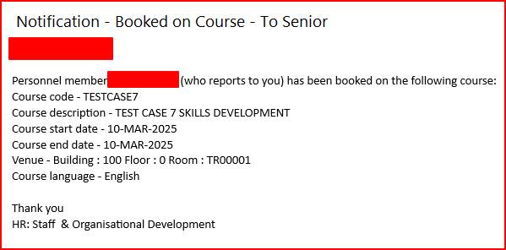
Walkthrough high level detail – Application for Courses
Examples of notifications

Slide 53
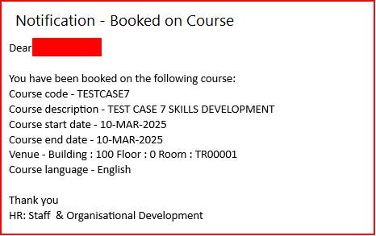
Walkthrough high level detail – Application for Courses
Examples of notifications

Slide 54
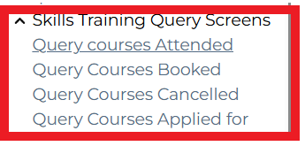
Walkthrough high level detail – Online query options
Examples

Slide 55
Walkthrough high level detail – Online query options
Examples
Query Courses Applied for
Query Courses Booked

Slide 56
Walkthrough high level detail – Online query options
Examples
Query Courses Attended
Query Courses Cancelled

Slide 57
Walkthrough high level detail – Reporting

Slide 58
DISCLAIMER
This presentation is only a summary of some of Adapt IT’s products, features and their latest developments. Adapt IT only intends for the information to give you an overview, and not a complete and comprehensive statement that necessarily suits your purposes.
Adapt IT reserves the right to change any information contained in this presentation and is not responsible for any loss that results from inaccuracies in the information. You may not distribute or reproduce the information without Adapt IT’s written permission.

